Slide 1
School of Engineering
and
Information Technology
Project Communications Management
&
Project Stakeholder Management

Slide 2
Learning objectives
  At the end of this topic you should be
  able to:
  Understand the purpose of communication in terms of the exchange of information
  Discuss the importance of Communications Management
  Describe different communication methods and discuss their appropriate use
  Describe the contents of a Communications Management Plan
  Describe the advantages and disadvantages of written and verbal communication

Slide 3
Learning objectives cont.
  At the end of this topic you should be
  able to:
  Understand the necessity of Stakeholder management in terms of the exchange of sensitive and confidential information
  Discuss the importance of Stakeholder Management

Slide 4
Importance of Good Communications
The greatest threat to many projects is a failure to communicate effectively
Our culture does not portray IT professionals as being good communicators
Research shows that IT professionals must be able to communicate effectively to succeed in their positions

Slide 5
Importance of Good Communications
Many experts agree that the greatest threat to the success of any project is a failure to communicate
Many project managers say that 90 percent of their job is communicating, yet many project managers fail to take the time to implement a plan for project communications

Slide 6
Communications Problems
Technical jargon causes problems for users/clients
Most IT personnel are experts in IT and have little training in communication
Listening skills are some of the hardest to learn
Writing skills are rarely emphasized in IT courses
Modern communication methods – such as email – are less formal than typical organizational methods and can easily be misinterpreted or misunderstood!

Slide 7
Communications Problems
Communication Management includes:
  listening, writing, planning, information distribution, performance reporting and management of stakeholders
Failure to communicate effectively leads to customer, staff and management dissatisfaction!
For all of these reasons (last 4 slides), it is
very important to understand that poor
communication and the lack of a project
communications plan demonstrates poor
management and is asking for trouble!!

Slide 8
Project Stakeholder Management
Introduced in 2013 by the PMI as a separate Management area in the 5th Edition of the PMI PMBOK
Stresses that stakeholder management as a part of communications management is of special importance
Communication to certain groups of stakeholders can cause some “pushback” if information is communicated in the “wrong tone” or even at all!!

Slide 9
Four Processes of Stakeholder Management
Identifying Stakeholders – Particularly grouping stakeholders with the same communication needs-
  Output: stakeholder register.
Planning – determine strategies to engage stakeholders throughout the project
  Outputs: Stakeholder management plan and document updates

Slide 10
Four Processes of Stakeholder Management cont
Managing Stakeholder Engagement – working with stakeholders throughout the project to meet their expectations and gain their engagement “buy in” to the project –
  Outputs: updates of the communications documents including issue logs
Controlling Stake holder Management- continue to be proactive and reactive to stakeholder “mood” to continue the buy in to the project
  Output: Updates of documents including work performance information

Slide 11
Why have separate Stakeholder Management?
Need to control information flow to avoid stakeholders from disengaging from the Project.
Stakeholder register to include information on:-
  Identification stakeholder details including their positions in the organisation (spheres of influence)
  Assessment information requirements of stakeholders during different phases of a project, Who do they influence?
  Classification Internal/external supporter or dissident?
Generally, the people politics of an organisation are ignored but with project management, finding the “natural leaders” in an organisation can lead to greater acceptance of a project and its outcomes if these people are brought into the projects ideals.
Stakeholders can be categorised as : Unaware, Resistant, Neutral, Supportive or Leading

Slide 12
Planning Stakeholder Management
Stakeholder management plan can include the following 5 areas:-
Current and desired levels of Engagement
  Align engagement levels if required
Interrelationships between stakeholders
  Keep abreast of internal politics of the organisation
Communications requirements
  Identify any specific additional communications needs of particular stakeholders (particularly influential stakeholders)
Potential Management Strategies for each stakeholder
  If needed develop individual strategies with key influencers (potentially sensitive)
Methods for updating the stakeholder management plan
  How to update the communications plane so to maintain the flexibility for the best stakeholder management

Slide 13
Project Communications
Management Processes
Identifying stakeholders: identifying everyone involved in or affected by the project and determining the best ways to manage relationships with them
Planning communications: determining the information and communication needs of the stakeholders
Distributing information: making needed information available to project stakeholders via the most effective methods and in a timely manner

Slide 14
Project Communications
Management Processes
Managing stakeholder expectations: managing communications to satisfy the needs and expectations of project stakeholders and to resolve issues
Reporting performance: collecting and disseminating project performance information, including status reports, progress measurement, and forecasting

Slide 15
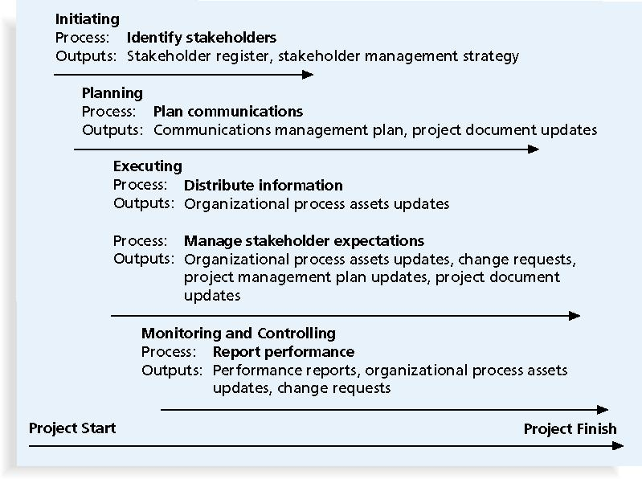
Project Communications Management Summary

Slide 16
Identifying Stakeholders
Need to identify who your particular project stakeholders are
Two key outputs of this process include:
  Stakeholder register: a document that includes details related to the identified project stakeholders
  Stakeholder management strategy: an approach to help increase the support of stakeholders throughout the project

Slide 17
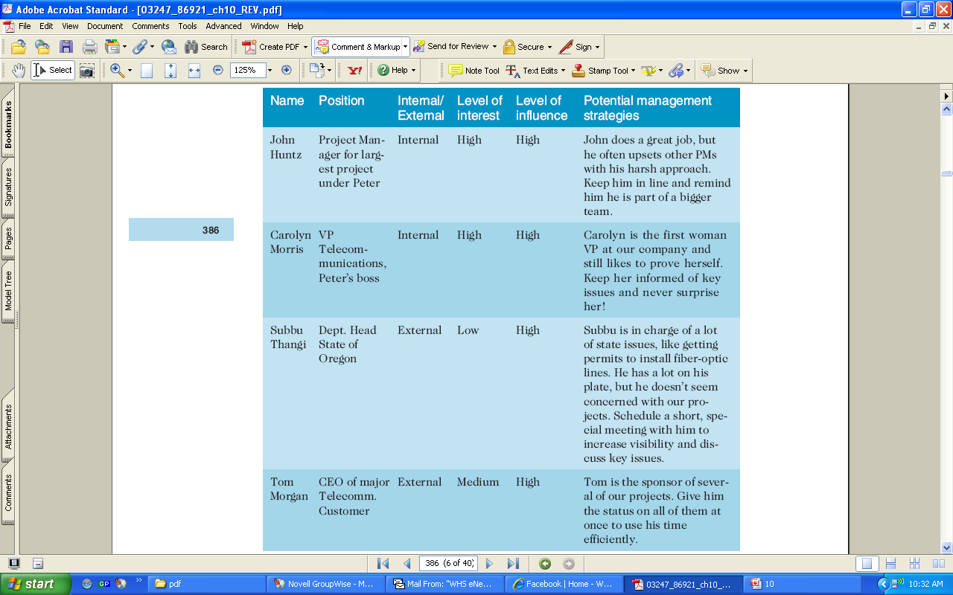
Stakeholder Management Strategy

Slide 18
Planning Communications
Every project should include some type of communications management plan, a document that guides project communications
Creating a stakeholder analysis for project communications aids in communications planning

Slide 19
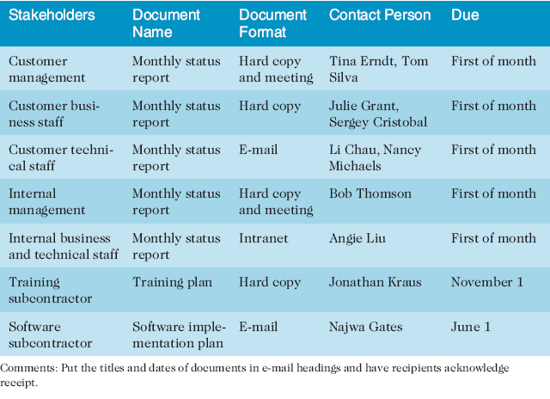
Stakeholder Analysis for Project Communications

Slide 20
Communications Management
Plan Contents
  Stakeholder communications requirements
  Information to be communicated (i.e. disseminating project information)
  Storage of project information
    Nominated repository and suggested version control system
  The people who are responsible for producing the information

Slide 21
Communications Management
Plan Contents
Information to be communicated:
  What information is to be distributed
  To whom will the information be distributed
  When will the information be distributed
Suggested methods or technologies for conveying information
Documentation formatting used for all documents and code - format, content, and level of detail of key project information

Slide 22
Communications Management
Plan Contents
Frequency of general communications
Responding to communications
  Including the regularity for team members to check their agreed communication method
Tone of communications (i.e. etiquette)
Escalation procedures for resolving issues
Revision procedures for updating the communications management plan
A glossary of common terminology

Slide 23
Distributing Information
Getting the right information to the right
people at the right time and in a useful
format is just as important as developing
the information in the first place
Important considerations include:
Using technology to enhance information
distribution
Formal and informal methods for distributing
information
Don’t bury crucial information
Don’t be afraid to report bad information

Slide 24
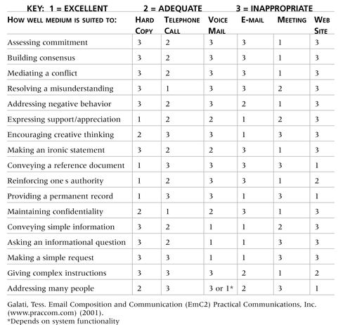
What style of communications to use?

Slide 25
Importance of Face-to-Face Communication
Research says that in a face-to-face interaction:
    58 percent of communication is through body language
    35 percent of communication is through how the words are said
    7 percent of communication is through the content or the actual words that are spoken
Pay attention to more than just the actual words someone is saying
A person’s tone of voice and body language say a lot about how he or she really feels

Slide 26
Email Etiquette
  Should be short
  May not necessarily be answered immediately
  Can be followed up with a phone call/meeting if necessary
  Beware flaming – do not instigate/do not respond
  Never send emails you are not prepared to have made public
Notes:
Keep emails short.
p Only ask one question per email.
p Answer all parts of an email.
p Answer within a day.
p Don’t get upset if you don’t receive an answer immediately.
p Don’t ignore it if you don’t get an answer within a day.
p Don’t keep emailing someone unresponsive—try a telephone or walk over to their office!
p Beware email flaming!
p If you get an email flame, ignore it—never reply by email!
p Don’t ask for read/received notifications: it is just not polite.
p Be wary of ‘reply all’.
p Never send emails that you are not prepared to have made public!
Make sure that e-mail is an appropriate medium for what you want to communicate.
Be sure to send the e-mail to the right people.
Use meaningful subject lines.
Limit the content to one main subject, and be as clear and concise as possible.

Slide 27
Personal Preferences Affect Communication Needs
Introverts like more private communications, while extroverts like to discuss things in public
Some people like to understand the big picture, while others prefer step-by-step details
Some want to know the logic behind decisions, while others want to know how something affects them personally

Slide 28
Other Communication Considerations
Rarely does the receiver interpret a message exactly as the sender intended
Geographic location and cultural background affect the complexity of project communications
    Different working hours
    Language barriers
    Different cultural norms

Slide 29
Setting the Stage for Communicating Bad News
Dear Mom and Dad, or should I say Grandma & Grandpa,
Yes, I am pregnant. No, I’m not married yet since Larry, my boyfriend, is out of a job. Larry’s employers just don’t seem to appreciate the skills he has learned since he quit high school. Larry looks much younger than you, Dad, even though he is three years older. I’m quitting college and getting a job so we can get an apartment before the baby is born. I found a beautiful apartment above a 24-hour auto repair garage with good insulation so the exhaust fumes and noise won’t bother us.
I’m very happy. I thought you would be too.
Love, Ashley
P.S. There is no Larry. I’m not pregnant. I’m not getting married. I’m not quitting school, but I am getting a “D” in Chemistry. I just wanted you to have some perspective.

Slide 30
Managing Stakeholders
Project managers (in this unit, all team members):
  Must understand and work with various stakeholders
  Need to devise a way to identify and resolve issues
An expectations management matrix can help clarify expectations

Slide 31
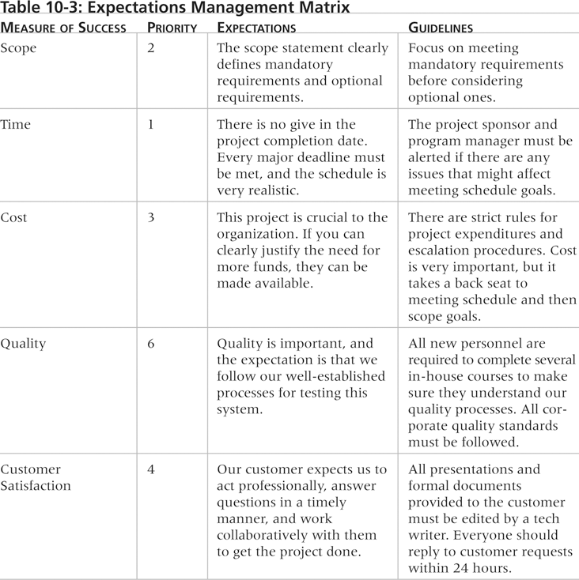
Expectations Management Matrix

Slide 32
Reporting Performance
Performance reporting keeps stakeholders
informed about how resources are being
used to achieve project objectives:
  Status reports describe where the project stands at a specific point in time
  Progress reports describe what the project team has accomplished during a certain period of time
    Requires progress measurement
  Forecasts predict future project status and progress based on past information and trends

Slide 33
Suggestions for Improving Project Communications
Manage conflicts effectively
Develop better communication skills
Run effective meetings
Use e-mail and other technologies effectively
Use templates for project communications

Slide 34
Running Effective Meetings
Determine if a meeting can be avoided
Define the purpose and intended outcome of the meeting
Determine who should attend the meeting
Provide an agenda to participants before the meeting
Prepare handouts and visual aids, and make logistical arrangements ahead of time
Run the meeting professionally
Build relationships

Slide 35
Using Electronic Communication,
and Collaborative Tools Effectively
Make sure that e-mail, instant messaging, virtual communication or collaborative tools are the most appropriate medium for what you want to communicate
Be sure to send information to the right people
Use meaningful subject lines, limit the content of e-mails to one main subject, and be as clear and concise as possible
Be sure to authorize the right people to share and edit your collaborative documents

Slide 36
Using Templates for Project Communications
Providing examples and templates for project communications saves time and money, and improves communication (and thus project) standards
Organizations can develop their own templates, use some provided by outside organizations, or use samples from textbooks
Research shows that companies that excel in project management make effective use of templates

Slide 37
Using Software to Assist in Project Communications
There are many software tools to aid in project communications
Today many people telecommute or work remotely at least part-time
Project management software includes new capabilities to enhance virtual communications
New tools, such as instant messaging and blogs, skype, and clouds can enhance project communications management

Slide 38
Summary
The goal of project communications management is to ensure timely and appropriate generation, collection, dissemination, storage, and disposition of project information
Main processes include:
  Identify stakeholders
  Plan communications
  Distribute information
  Manage stakeholder expectations
  Report performance

